Slide 1
KG Mini Program Info Night
Agenda:
Welcome and land acknowledgement
About King George
Introduction to our Mini Program!
Q&A

Slide 2

Welcome!
Jacob Ross-Ewart
Catalyst Coordinator & English Teacher kinggeorgemini@vsb.bc.ca
With deep gratitude and respect, we are honoured to be learning and unlearning on the ancestral and unceded lands of the xʷməθkʷəy̓əm (Musqueam), Sḵwxwú7mesh Úxwumixw (Squamish Nation) & səlilwətaɬ (Tsleil-Waututh Nation).

Slide 3
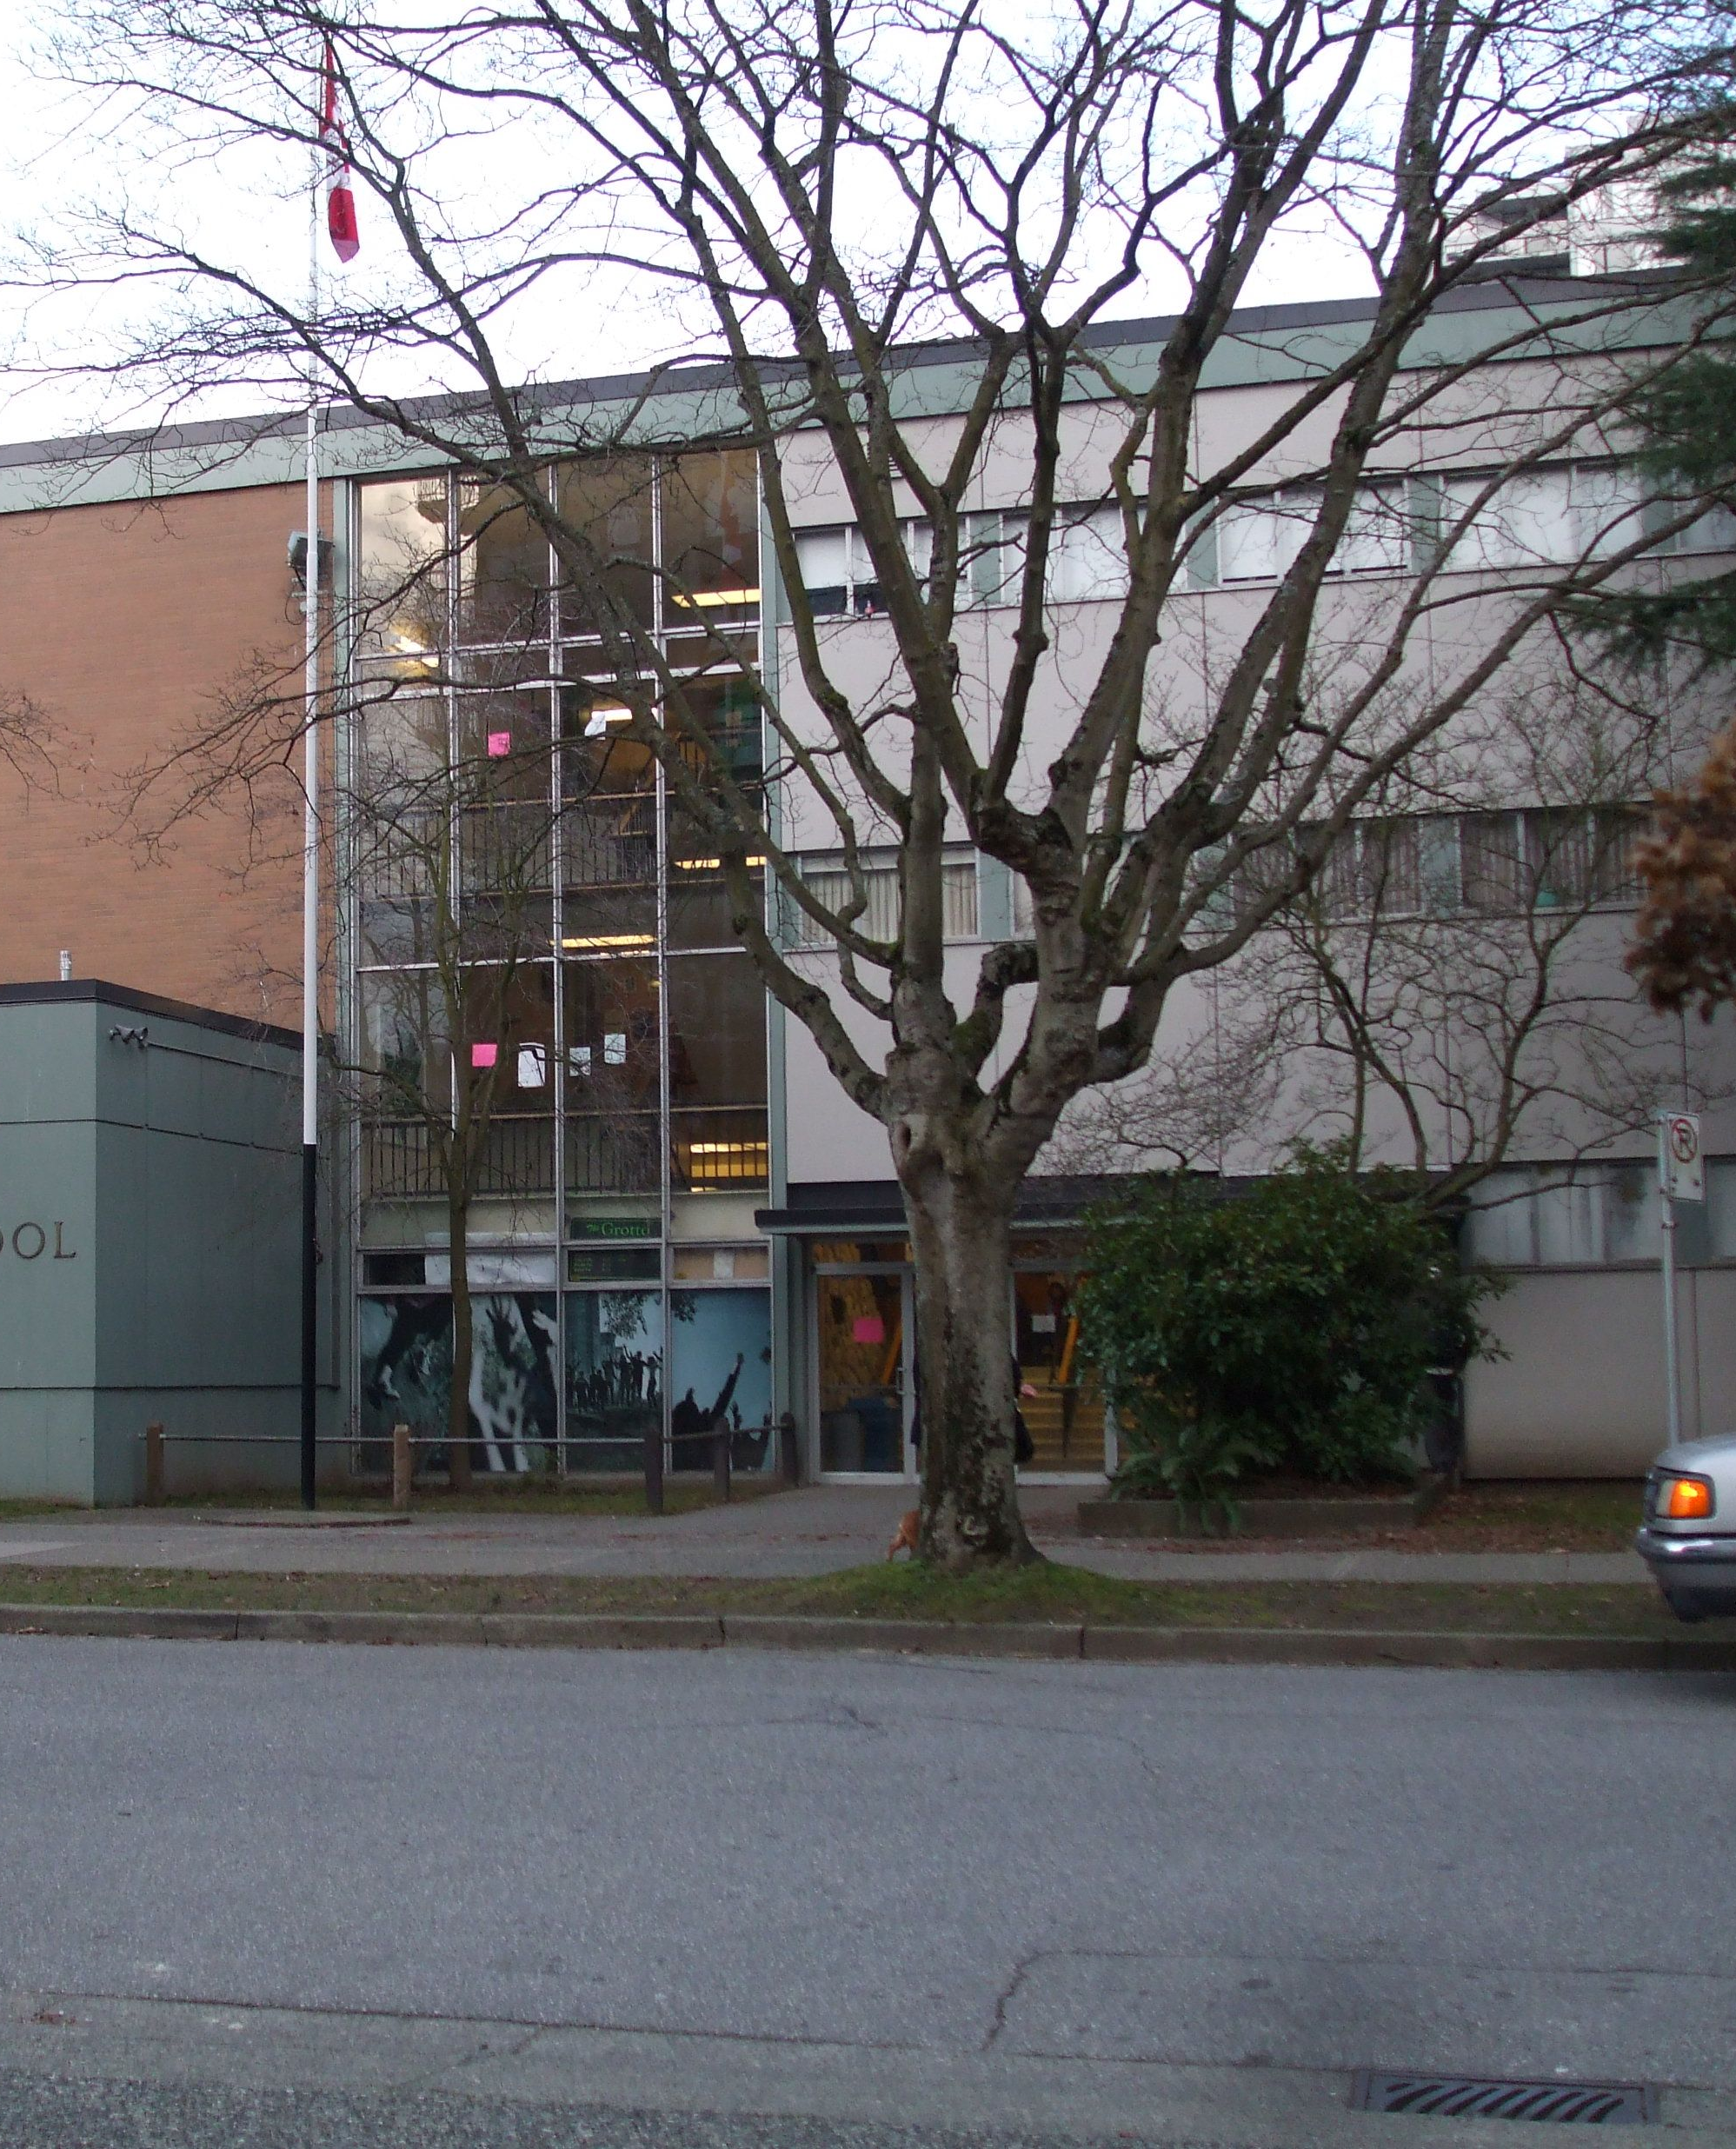
About King George Secondary
Small school (approx. 640 students)
Centrally located in West End
Coordinate with multiple community groups: WECC, Gordon Neighbourhood House, etc.
Diverse student population - 30+ home languages
District leader in supporting students’ learning needs

Slide 4


Impact, Inspire, Ignite

Slide 5
Catalyst is a unique program that provides a cohort learning environment in the heart of Downtown Vancouver. Over 5 years at King George, students will receive a wide range of opportunities for academic enrichment as well as coaching and mentorship towards becoming a leader in their school community. Upon graduating high school, students will have developed a strong C.V. for applying to post-secondary institutions or joining the workforce.

Slide 6
Grade 8
Catalyst Courses: English 8, Social Studies 8, Science 8, Math 8&9
Non-Catalyst courses: French 8, PHE 8, ”Elective” Rotations

Slide 7
Grade 9
Catalyst Courses: English 9, Social Studies 9, Science 9, PHE 9*
Non-Catalyst courses: French 9, Math9 or 10, Elective courses**
* This course will teach leadership skills and team-building strategies through the lens of PHE.
** Students choose two elective courses from a list that usually includes: Textiles, Foods, Art, Drama, Tech Studies, Music, Photography, etc.

Slide 8
Grade 10
Catalyst Course: CLE 10
Course proposal under review. Guided self-study project where students undergo an inquiry process in an area of personal interest.

Slide 9
Grades 11&12
Elective Course: Senior Leadership
During their final two years of high school, Catalyst students build off their prior learning and the knowledge they have gained during their independent study project. Through the Senior Leadership course, they begin to identify areas in the school or the surrounding community where their own knowledge, passion, and leadership can effect meaningful change, and work to bring projects to life that benefit their school and the downtown communities. Not required for completion of Catalyst.

Slide 10
Extracurricular Activities
Service, Active, and Creative requirements:
Throughout their participation in Catalyst, students are expected to participate in a selection of extracurricular activities at the school.
Year | Option 1 | Option 2
Grade 8, 9, 10 | Sports team LRP Cadets etc | School Play Student Council Rock band etc
Grade 11, 12 | Coaching/managing a junior team Senior sports Student Council Executive etc | Self-directed leadership opportunity

Slide 11
Additional Benefits*
Catalyst English 8 - Class trip to Bard on the Beach*
Catalyst English 9 – Media Studies unit – trip to VIFF*
Catalyst Social Studies 8 & 9 – Student government mini-unit and voting bloc
PHE Leadership 9 – Students organize and run intramural sports leagues
Additional opportunities for class field trips (escape room, Science World, downtown walking tour, etc.)
*Depending on which semester the course is scheduled in

Slide 12
Entry Requirements
Students are a good fit for the Catalyst program when they:
Demonstrate leadership abilities in classroom and extracurricular situations.
Are passionate about their hobbies and interests.
Are committed to improving their skills in a wide range of subjects, regardless of their current ability.
Completion of application form, written answers, and participation in a group interview process in the spring (if short-listed).

Slide 13
Key Dates
Wednesday, October 15 – Info Session
November 10 – Applications open on District Website
  NOTE: You must apply to both the District website and through the KG Mini Program website
Mid-End November – Elementary School Visits
Thursday, December 18 – Application deadline (Both Catalyst and District)

Slide 14
Questions?
Jacob Ross-Ewart kinggeorgemini@vsb.bc.ca

